Slide 1

Business Analyst Career Program - Capstone Project
By < Sushmita Kumari Gupta >

Slide 2
Data Summary As per my understanding the give data set give info about the company sales of there product Segment column represent Segment there are 5 segment
Country column represent in which country we are selling our product we are selling our product in 5 country
Product column represents what product we are selling and we have 6 product
Unit sold column represents how much unit we are sold
Manufacturing price column represents the how much money take to make a product
Sales price column represents the selling cost of each product
Discount represents how much discount we are giving in each product
COGS column represents the total making of product
Profit column represents the total profit we are making in each product
Date column represents the day we are selling our product

Slide 3
Data Cleaning for upload file in SQL
When I check the dataset I under stand that data is clean already but to upload the dataset in SQL we have to make some change in column to upload the data
I check the data types of column and make some changes according SQL requirement
Then I remove all the currency symbols that present in the data
Then I change the data format form dd-mm-yyyy to yyyy-mm-dd because SQL accept the yyyy-mm-dd format
After all this changes my file uploaded to My SQL Workbench

Slide 4
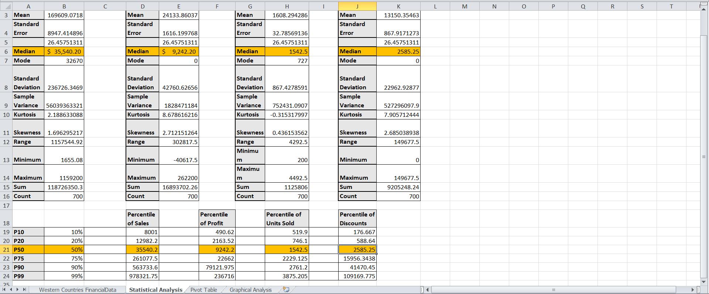
Statistical Analysis

Slide 5
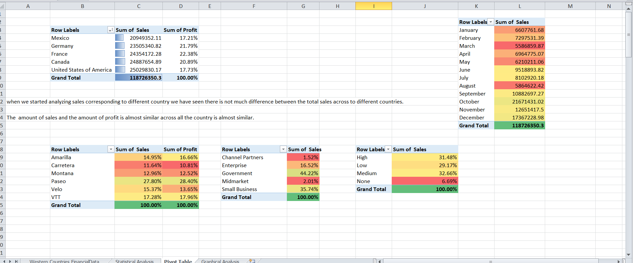
Pivot Table

Slide 6
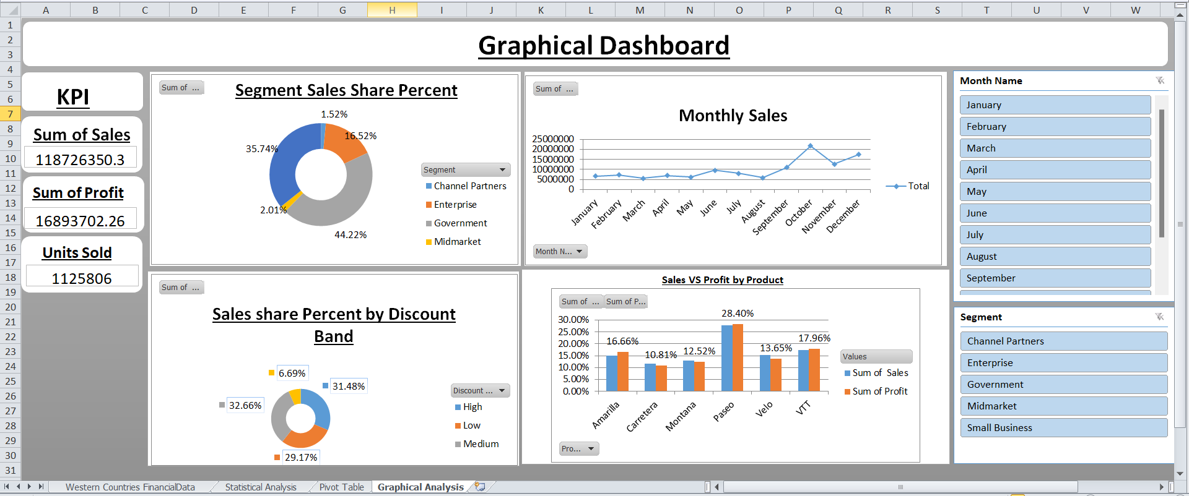
Graphical Dashboard
In this analysis I made graphical representation of Raw data that help us to understand the data easily and insert some filter in the Dashboard that help us to change the data as per our requirement
First graph represents the sales share percentage by segment
Second graph represents the monthly sales
Third graph represents the percentage of units sold by discount band
Forth graph represents the sales and profit by product type

Slide 7
Instruction to Import data in SQL
Make some changes in data with the help of excel and changing the data types of some columns
The creating the database in SQL
Then with the help of table data import wizard importing the data in SQL successfully
Then run a query (select * from sql_data) to check that table is import or not
After importing the data performed some queries and fetch some insights from data

Slide 8
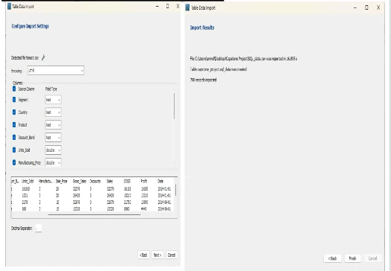
Inserting The Data in SQL

Slide 9
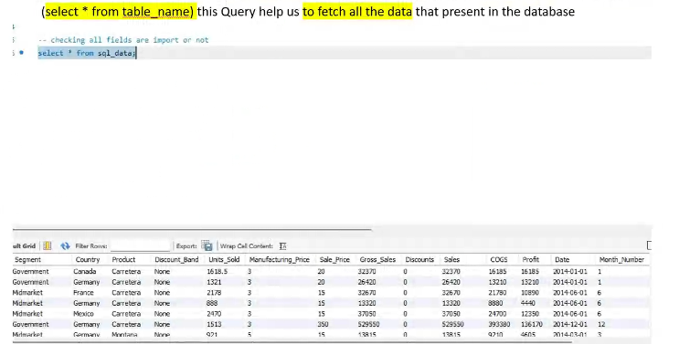
Checking The Data is Import Successfully

Slide 10
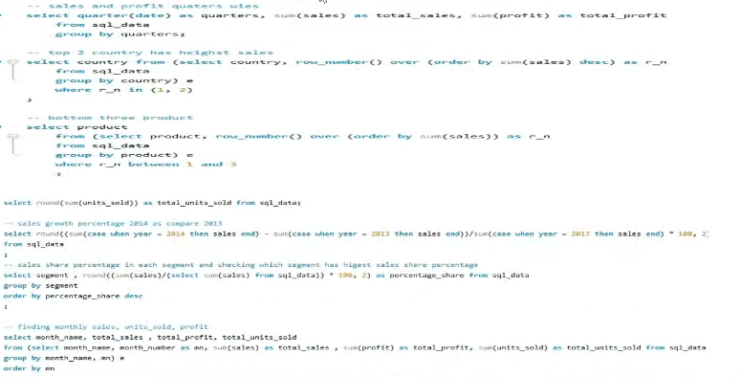
Performing Some Queries

Slide 11
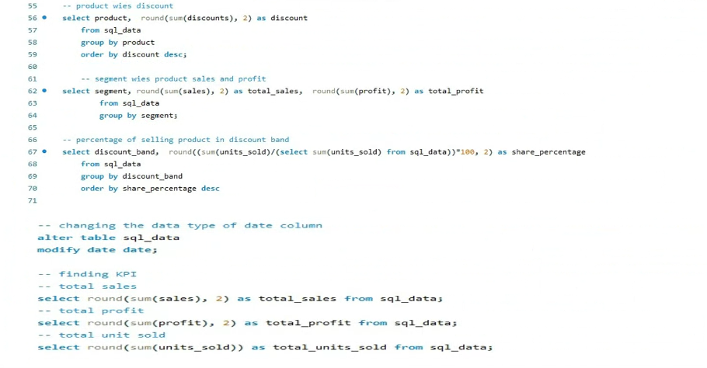
Some Queries

Slide 12
Importing data from SQL to Power BI
1. To connect data from SQL to Power BI
First import data in SQL Server Management Studio
Then copy the Server name
Open Power BI click Get Data and select SQL Server
Then paste the Server name that you copied first
Then type the table name if you want
Then click Connect then click on Load Data

Slide 13
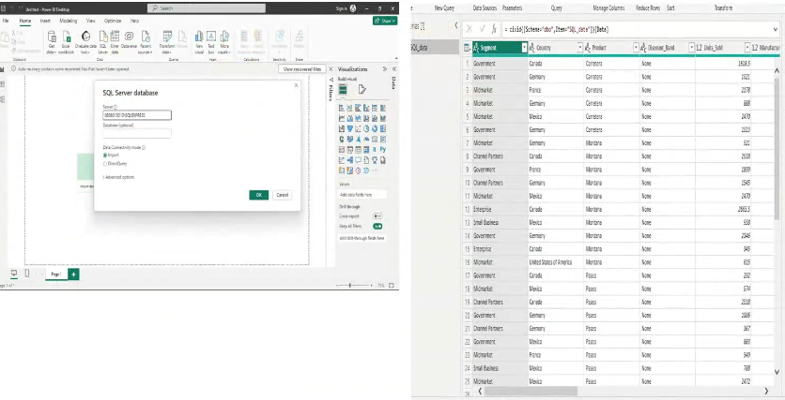
SQL to Power BI Connection

Slide 14
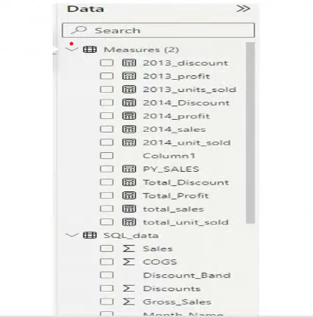
Creating Some Measures
Creating new Table
Creating New measures as per our need with the help of DAX (Data Analysis Expression)

Slide 15
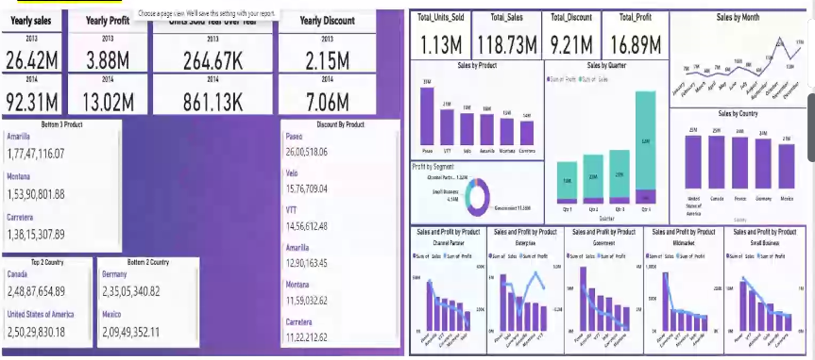
Dashboard
I made two Dashboard One is KPI dashboard and Second is Graphical dashboard

Slide 16
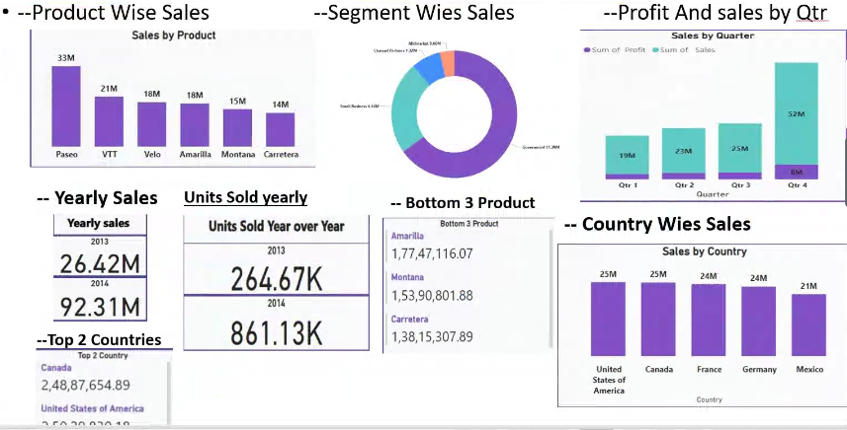
Dashboard

Slide 17
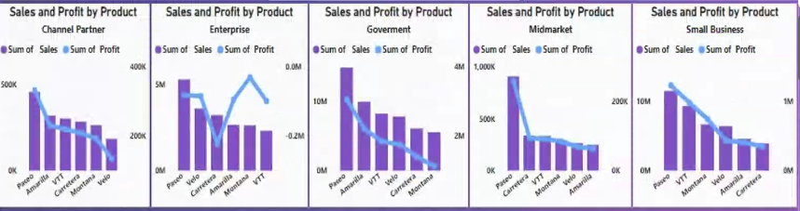
Segment Wise Product Sales and Profit
There are two difference Question Segment wise Product sales and second one is segment wise product profit
But I use a combination chart for this both question and combine both of them in one
For making this chart first select the combination chart then select product then sales and profit measures and putting the segment in filter and select the segment type

Slide 18
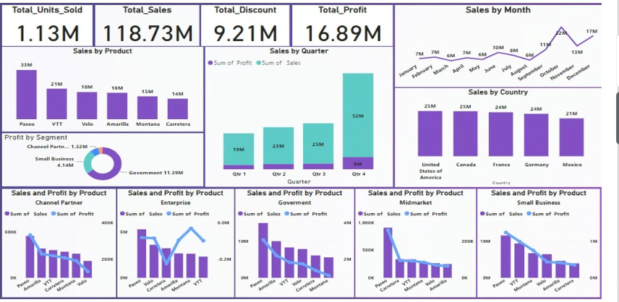
Dashboard

Slide 19
Conclusion of Dashboard
After analyzing the statistical analysis and graphical analysis and dashboard I draw a conclusion that we should stop spelling our product in enterprises segment because we are having big loss in enterprises segment we should more focused on small business and government segment
As compare last year we increased our product sales and we should more focused on paseo product because that our hero product
As we can see in discount band sales share graph we came to know that none discount band category has only 6.69% of sales share
And we should more focused in government segment because it has 44.22% sales share
Our country wise sales were going good there are not that big difference in country category.

